Slide 1
.NET Core Performance Monitor
How it Works, Demo, and Moving Forward
Notes:
Jacob: We’re the explorer pod on the .NET Core R & P team. For the past 11 weeks we’ve been working on a Performance Monitor to track .NET applications

Slide 2
Introduction

Slide 3
Who We Are
Jacob Kirsch
McCoy Patiño
Rising junior at University of Pennsylvania studying CS & Math
Rising junior at MIT studying CS & Japanese
Rising junior at University of Michigan studying CS & Information Studies
Monal Garg

Slide 4
What's the Issue?
Performance tracking exists (Azure Application Insights, Windows Performance Monitor, etc.) but is limited
App Insights targeted towards web applications
Windows Performance Monitor not cross-platform
Multi-process application-focused monitoring doesn't exist in an accessible form
Notes:
McCoy: so first, we want to establish why this performance monitor is necessary or desirable in the first place. What problem are we trying to solve? Currently, two of the biggest performance monitoring tools for .NET Core applications are Azure App Insights and Windows Performance Monitor, or “PerfMon”. These are great tools, but in App Insights’ case, it’s geared primarily towards web apps – as such, the breadth of performance metrics for developers is mostly limited to things like request handling performance. The Windows Performance Monitor has much more detailed analysis of performance, but as the name suggests, it’s limited to Windows users – which kind of defeats the purpose of .NET being usable on multiple platforms if you can’t track application performance on all those platforms. And last, and maybe most importantly, these tools aren’t made to help developers monitor .NET applications as a whole, multi-process or *multi-microservice* application. It’s hard to get a full picture of your holistic application performance if you can’t indicate that certain, distinct processes all contribute to the same whole application.

Slide 5
What is the .NET Core Performance Monitor?
Cross-platform, application neutral performance monitor
Candidate reference application for .NET Core
Locally deployable, easy to run web application
Notes:
.NET Core Performance Monitor is a cross-platform, application neutral performance monitor that helps users, which would be .NET Core app developers, understand the health of their applications by showing them details of useful metrics. It is locally deployable and the web application can be easily run.

Slide 6
How it Works

Slide 7
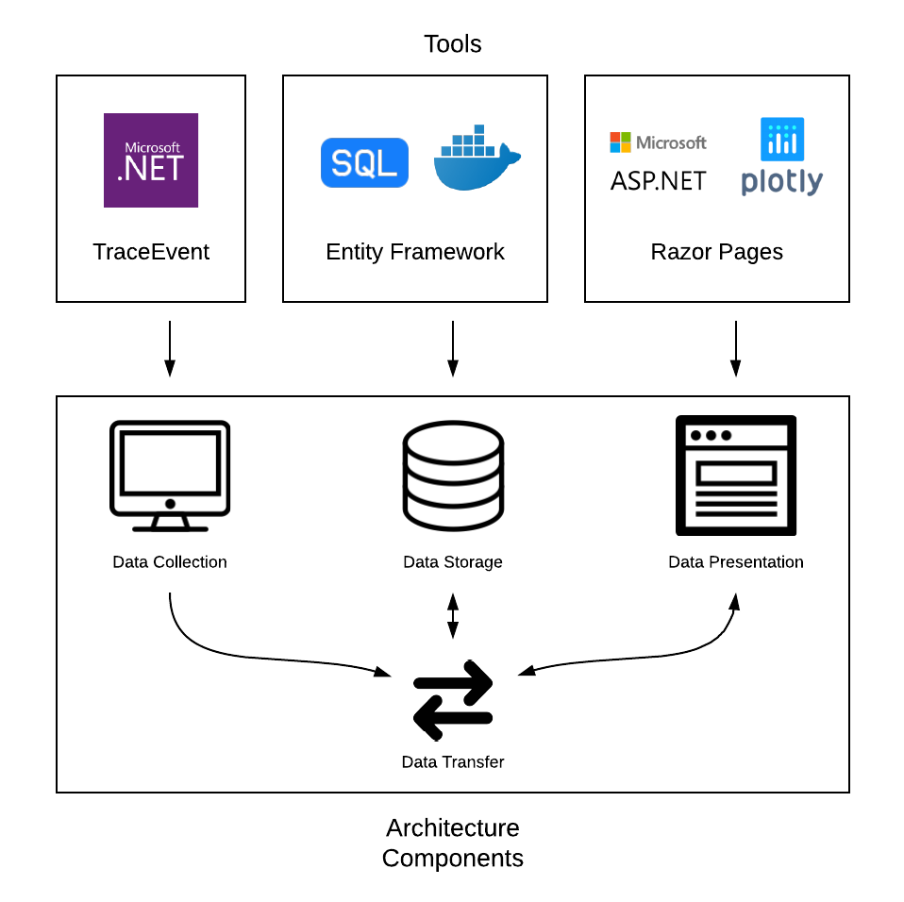
Architecture
Three major components:
Data Collection (class library)
Data Storage (database)
Data Presentation (UI)
Data transfer system connects all three
Notes:
Jacob: Three components. A configurable class library that collects information on each process that uses trace event to monitor specific metrics, a SQL server that stores process data, and a user interface built through Razor pages to view and explore the data of each process. All are connected with through an API built on entity framework that handles the transfer of data between each microservice.

Slide 8


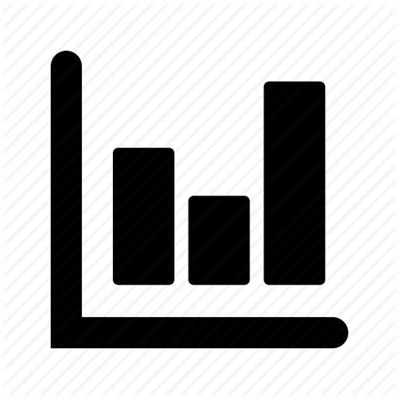
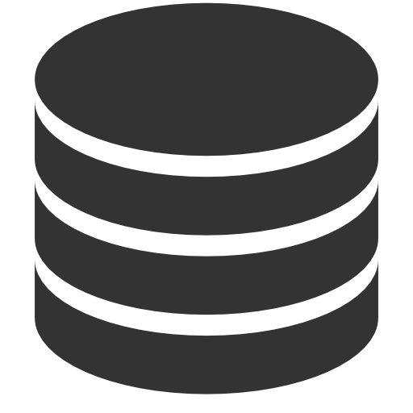
Monitoring
Data Transfer
User Interface
Requests process – specific data
Monitor 1 data
Manages HTTP requests & access to server
Receives data from server
Process 1
Monitor 2 data
Displays process data in graphs and tables
Monitor instance 1
Process 2
Data Storage
Monitor instance 2
Application
Stores process data
Notes:
McCoy: this diagram shows how data flows within the Performance Monitor – data is initially collected by the monitoring component on the user’s machine, through a class library that’s utilized by the user’s code directly. In this example, you can see that multiple processes on the user’s machine can be simultaneously monitored and logically grouped into a single application of interest. Each of these processes will send its performance data to the server via HTTP requests, and this data will be accepted and appropriately stored in a SQL database through Entity Framework. When a request for data is made on the front end, an HTTP request is sent to the server to fetch the information and display it appropriately in the form of graphs and tables. Processes that belong to the same application will be logically grouped that way on the UI, but data is viewable for individual processes.

Slide 9
The Demo
Notes:
Go over how to implement monitor with just process and app name specified from start to finish, show tracking on screen. Emphasize that more configurability will be shown in another demo shortly.

Slide 10
Data Collection
Performed through class library (in future, obtainable via NuGet)
Uses .NET Core API and TraceEvent library
Tracks the following metrics:
- CPU usage
- Memory usage
- Incoming Kestrel HTTP requests
- Exceptions
- Garbage Collection
- Thread contention
- JIT events
Notes:
HTTP: method, path, duration, request frequency
Exceptions: type, frequency by type
GC: type, frequency by type
Contention: duration, frequency of events
JIT: method, count

Slide 11
Data Transfer
Entity Framework
Data sent as single package
Session class with foreign key
Maps to all data points
Swagger implemented for API viewing
Simple database setup
Running scripts and changing connection string
Notes:
Data transfer is handled through entity framework. The monitor class send the data as a single json, which included a session class that contains the application and process name. Once the API receives the data, it maps a single session object as a foreign key for the datapoints being received with the session. This decreases the overhead in the databases, while ensuring that data is separated by both application and process. Swagger has been implemented in the API for testing, and can be viewed through the browser. This helps with debugging on any future updates. Lastly, a config file has been created that includes the connection string to where the server will be.

Slide 12
Data Storage
Session class
Stores information of current process
Unique id
Maps to relevant data points
Tables for each data point
Scripts written for table creation
session table -> data point tables
Set up in any SQL database
Notes:
The session class is the core of the data storage. Through this you can view any process within an application, as well as the datapoints related to this process. There are also separate tables for each datapoint, and scripts that can be quickly run for the creation of the tables within a database. This microservice is easy to set up in any database as all that is required is running a few scripts and changing a connection string to point towards the correct server.

Slide 13
Data Presentation
Received as JSON
Accessed by Razor Pages
Shown through Plotly and Tables
Data Analysis
Top exceptions
Averages (ex. avg CPU usage)
Duration of HTTP requests, contentions
Notes:
The web application calls the web api to retrieve data as JSON. Once the data is deserialized into the associated C# objects, this data can be accessed by razor pages and is shown through tables. The data that is fed to plotly, which constructs the graphs, is retrieved through the fetch api in javascript. The fetch api is called every few seconds (the exact time depends on the rate that the data is sent to the server), which allows for the graph to be continuously updated. The web application also performs some data analysis (for example, it calculates averages, duration of http requests and contentions, and sorts exceptions by frequency).

Slide 14
Moving Forward

Slide 15
Current Feature Improvement
Data Collection
Reduced process memory overhead (currently ~9-10 MB)
Streamlined enabling of metric tracing
Circular memory buffers
Data Storage
Single script table creation
Data Presentation
Improve database security
Graphs for other metrics (ex. Total http requests over time)
User experience (ex. selecting a top exception highlights all of those exceptions in the table)

Slide 16
Features to Add
Data Collection
More performance metrics
Data Storage
EF Migrations
More data points
Simplification of controllers
Data Presentation
Cross-platform event tracing
SignalR to continuously update tables
Cross process data analysis

Slide 17
Project Handoff
GitHub repository set up
Set as public
Brian Robbins as lead
Notes:
There is a GitHub repository in the .NET Architecture group. It is now set to public so anyone can view it. Brian Robbins will be taking over the project and repository as we leave.

Slide 18

Links
GitHub repo: https://github.com/dotnet-architecture/PerformanceMonitor
Emails
jbkirsch@umich.edu - Jacob
mgarg@sas.upenn.edu - Monal
mccoyp@mit.edu - McCoy

